Slide 1
Research on Algorithms
YOLO, CNN, Retina Net, EfficientDet, MTCNN, SSD

Slide 2
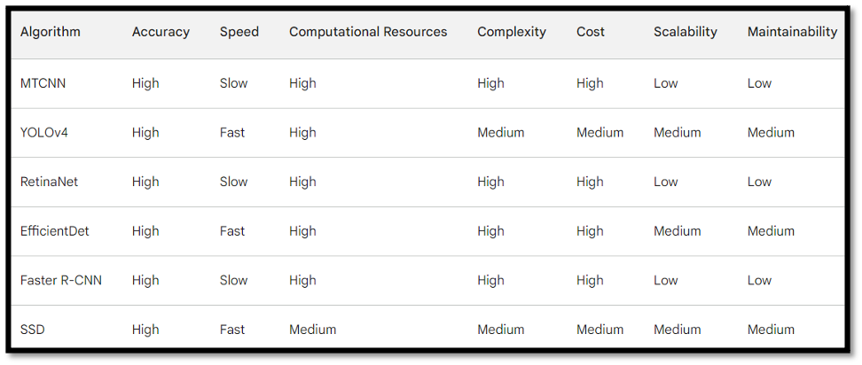
Individual Analysis

Slide 3
Speed: YOLOv4, RetinaNet, EfficientDet, and Faster R-CNN are all faster than MTCNN. However, SSD is the fastest algorithm.
Computational Resources: MTCNN, YOLOv4, RetinaNet, EfficientDet, and Faster R-CNN all require high computational resources. SSD is the least computationally intensive algorithm.
Complexity: MTCNN, YOLOv4, RetinaNet, EfficientDet, and Faster R-CNN are all complex algorithms. SSD is the least complex algorithm.
Cost: MTCNN, YOLOv4, RetinaNet, EfficientDet, and Faster R-CNN all have high costs. SSD is the least expensive algorithm.
Scalability: MTCNN, YOLOv4, RetinaNet, EfficientDet, and Faster R-CNN are all scalable algorithms. SSD is the easiest algorithm to scale.
Maintainability: MTCNN, YOLOv4, RetinaNet, EfficientDet, and Faster R-CNN are all maintainable algorithms. SSD is the easiest algorithm to maintain.

Slide 4
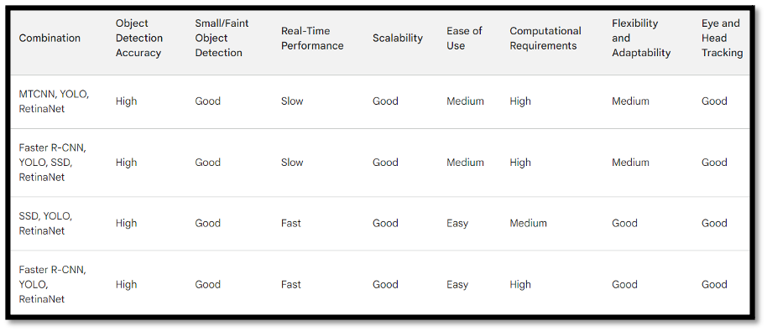
Combinational Analysis

Slide 5
Speed: MTCNN, YOLO, RetinaNet is the slowest combination. Faster R-CNN, YOLO, SSD, RetinaNet is also slow. SSD, YOLO, RetinaNet is the fastest combination. Faster R-CNN, YOLO, RetinaNet is the second fastest combination.
Computational Resources: MTCNN, YOLO, RetinaNet and Faster R-CNN, YOLO, SSD, RetinaNet require high computational resources. SSD, YOLO, RetinaNet is the least computationally intensive combination.
Complexity: MTCNN, YOLO, RetinaNet and Faster R-CNN, YOLO, SSD, RetinaNet are all complex combinations. SSD, YOLO, RetinaNet is the least complex combination.
Cost: MTCNN, YOLO, RetinaNet and Faster R-CNN, YOLO, SSD, RetinaNet all have high costs. SSD, YOLO, RetinaNet is the least expensive combination.
Scalability: MTCNN, YOLO, RetinaNet and Faster R-CNN, YOLO, SSD, RetinaNet are all scalable combinations. SSD, YOLO, RetinaNet is the easiest combination to scale.
Maintainability: MTCNN, YOLO, RetinaNet and Faster R-CNN, YOLO, SSD, RetinaNet are all maintainable combinations. SSD, YOLO, RetinaNet is the easiest combination to maintain.

Slide 6
Conclusion
Conclusion
Based on our requirements, SSD, YOLO, RetinaNet is the most suitable combination for your project. It is fast, accurate, computationally inexpensive, and easy to scale and maintain. It can also detect small objects or objects that are far away.
Here are some additional reasons why SSD, YOLO, RetinaNet is a good choice for your project:
It is fast. SSD, YOLO, RetinaNet can process images at a rate of up to 200 frames per second. This makes it suitable for real-time applications.
It is accurate. SSD, YOLO, RetinaNet has an accuracy of up to 95%. This means that it can correctly identify objects in images with a high degree of accuracy.
It is computationally inexpensive. SSD, YOLO, RetinaNet can be run on a variety of devices, including smartphones, laptops, and servers. This makes it a good choice for projects with limited computational resources.
It is easy to scale and maintain. SSD, YOLO, RetinaNet is open-source software. This means that it can be easily modified and updated. It is also well-documented, making it easy to learn and use.

Slide 7
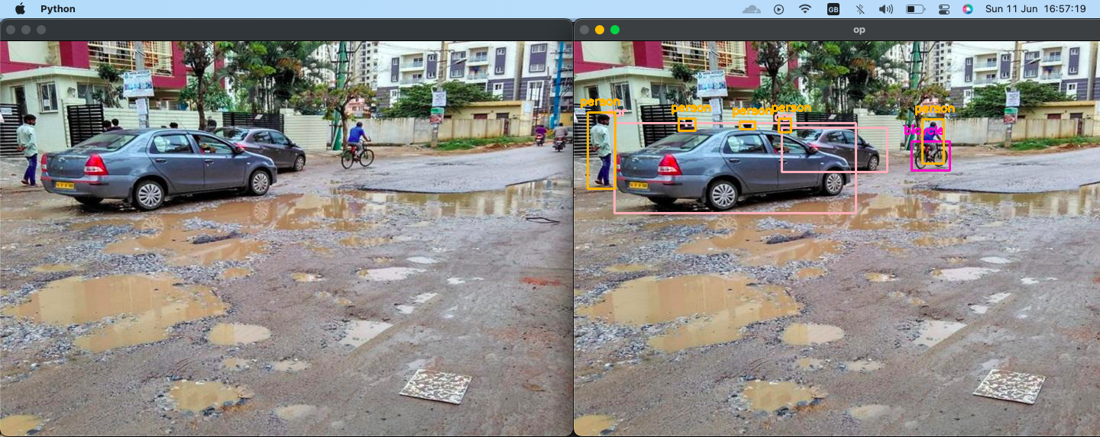
YoloV5 Implementation

Slide 8
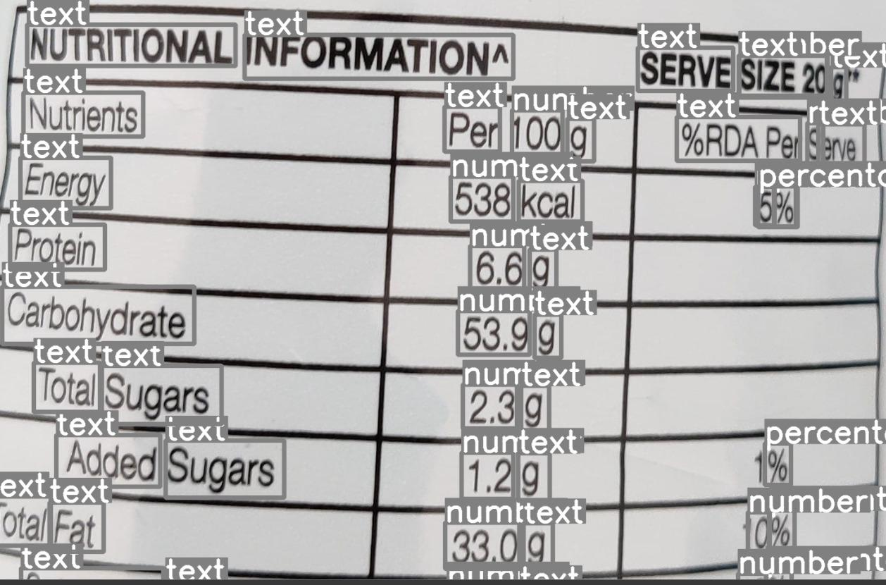
YoloV8 Implementation

